Slide 1
Using Pandas and Python to Analyze Big Data
Do you decide analyze a large dataset to start exploring interesting insights, but you’re not sure how do that?
Pandas is a Python library used for working with data sets. The name "Pandas" has a reference to both "Panel Data", and "Python Data Analysis" and was created by Wes McKinney in 2008.
It has functions for analyzing, cleaning, exploring, and manipulating data. With these tools, you’ll be able to slice a large dataset down into manageable parts and glean insight from that information.
Pandas can take in a huge variety of data, the most common ones are csv, excel, sql or even a webpage.

Slide 2
Setting Up Your Environment
You can follow along in any terminal that has Python 3 installed. If you want to see nicer output, especially for the large dataset you’ll be working with, then you might want to run the examples in a Jupyter Notebook or Replica.
The last thing you’ll need is the Pandas Python library, which you can install with pip:
$ python -m pip install pandas
You can also use the Conda package manager:
$ conda install pandas

Slide 3
Import Pandas
Once Pandas is installed, import it in your applications by adding the import keyword:
import pandas
Now Pandas is imported and ready to use.

Slide 4
Pandas as pd
Pandas is usually imported under the pd alias . Alias are an alternate name for referring to the same thing!
Create an alias with the as keyword while importing :
import pandas as pd
Now the pandas package can be referred to as pd instead of pandas
mylist = ["apple", "banana", "cherry"]

Slide 5
List
Lists are used to store multiple items in a single variable.
Lists are one of 4 built-in data types in Python used to store collections of data, the other 3 are Tuple, Set, and Dictionary, all with different qualities and usage.
List items are ordered, changeable, and allow duplicate values.
List items are indexed , the first item has index [0], the second item has index [1] etc.
thislist = ["apple", "banana", "cherry"] print (thislist)

Slide 6
Dictionary
Dictionaries are used to store data values in key : value pairs.
A dictionary is a collection which is unordered, changeable and does not allow duplicates
The values in dictionary items can be of any data type
Dictionaries are written with curly brackets, and have keys and values:
thisdict = { "brand": "Ford", "electric": False, "year": 1964, "colors": ["red", "white", "blue"] } print (thisdict)

Slide 7
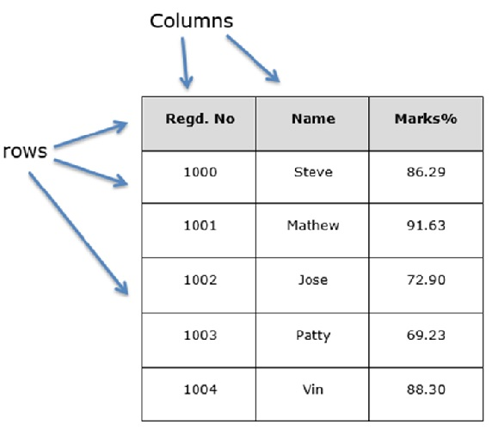
Data Frame
A Pandas Data Frame is a 2 dimensional data structure, like a 2 dimensional array, or a table with rows and columns. Dictionaries are used to store data values in key : value pairs. When using python dictionary of lists , the Dictionary Keys will be used as columns headers and the values in each List as Columns of the Data Frame
Features of Data Frame
Potentially columns are of different types
Size – Mutable
Labeled axes (rows and columns)
Can Perform Arithmetic operations on rows and columns

Slide 8
Data frame
data = { "calories": [420, 380, 390] , "duration": [50, 40, 45] } #load data into a DataFrame object: df = pd.DataFrame(data) print(df)

Slide 9
Series
A Pandas Series is like a column in a table. It is a one-dimensional array holding data of any type.
a = [1, 7, 2] myvar = pd.Series(a) print (myvar)

Slide 10
Labels
If noting else is specified, the values are labeled with their index number. First value has index 0, second value has index 1 etc… , This label can be used to access a specified value.
With the index argument, you can name your own labels.
a = [1, 7, 2] myvar = pd.Series(a, index = ["x", "y", "z"]) print(myvar)

Slide 11
Key/Value Objects as Series
You can also use a key/value object, like a dictionary, when creating a Series.
To select only some of the items in the dictionary, use the index argument and specify only the items you want to include in series.
calories = {"day1": 420, "day2": 380, "day3": 390} myvar = pd.Series(calories) print(myvar)

Slide 12
Load Files Into a Data Frame
If your data sets are stored in a file, Pandas can load them into a Data Frame.
A simple way to store big data sets is to use CSV files (comma separated files , Comma_delimited).CSV files contains plain text and is a well know format that can be read by everyone including Pandas. Pandas provides the read_csv function to read data stored as a csv file into a pandas DataFrame. Whereas read_* functions are used data to pandas , the to_* methods are used to store data.
import pandas as pd df = pd.read_csv('data.csv') print(df)

Slide 13
Load Files Into a Data Frame
If your data sets are stored in a Excel file , first need to import xlrd library and use .open_workbook method to read excel file also .sheet_by_name to achive Excell sheet and use pandas to load them into DataFrame.
import xlrd2
import pandas as pd
workbook = xlrd2.open_workbook("Olympia.xlsx")
sheet = workbook.sheet_by_name("Sheet1")
df = pd.DataFrame(sheet)
print(df)

Slide 14
Getting to Know Your Data
You’ve imported a CSV file with the Pandas Python library and had a first look at the contents of your dataset. So far, you’ve only seen the size of your dataset and its first and last few rows. Next, you’ll learn how to examine your data more systematically
You can display all columns and their data types with .info():
df.info()

Slide 15
How much data
You use the Python built-in function len() to determine the number of rows. You also use the .shape attribute of the Data Frame to see its dimensionality. The result is a tuple containing the number of rows and columns.
len(df)
df.shape
You can have a look at the first five rows with .head():
df.head()
You can display the last five rows with .tail() instead:
df.tail()

Slide 16

SELECT SPECIFIC COLUMNS FROM A DATAFRAME
To select a single column, use square brackets [ ] with the column name of the column of interest. To select multiple columns, use a list of column names within the selection brackets[ [ ] ] .
athlete = df [“Athlete “]
athlete_age = df[ [ “Athlete” , “Age”]]
athlete_age = df[ [ “Athlete” , “Age”]] .shape
print( “athlete_age “)

Slide 17
conditional expression
To select rows based on a conditional expression , use a condition inside the selection brackets[ ]
above_20 = df[ df[ [“ Age “] > 20 ]
The isin() conditional function returns true for each row that values are in the provided list!
age = df [df[“ Age “].isin([24 , 23])
When combing multiple condition statements , each condition must be surrounded by parentheses(). Moreover , you can not use or/and but need to use the or operator | and the and operator & (Arithmetic Operators).
age = df [ (df[“Age”] == 23) | (df[“Age”] == 24)]

Slide 18
Select Specific rows and columns
The loc/iloc operators are required in front of the selection brackets[] . When using loc/iloc , the pat before the comma is rows you want, and the part after the comma is the columns you want to select.
Athlete_names = df.loc[ df[“Age”] > 20 , Athlete]
When specifically interested in certain rows and/or columns based on their position in the table , use the iloc operator in front of the selection brackets[]
sp_rc = df.iloc[ 7 : 13 , 1 : 4 ]
When selecting specific rows and/or columns with loc or iloc, new values can be assigned to the selected data.
df.iloc[ 1:2 , 7] = “None”
print(df.tostring())

Slide 19
How to create plots in Pandas
Matplotlib is a low level graph plotting library in python that serves as a visualization utility. Matplotlib was created by John D. Hunter. Matplotlib is open source and we can use it freely.
If you have Python and PIP already installed on a system, then installation of Matplotlib is very easy.
Install it using this command:
pip install matplotlib
Once matplolib is installed, import it in your application by adding the import module statement:
import matplotlib

Slide 20
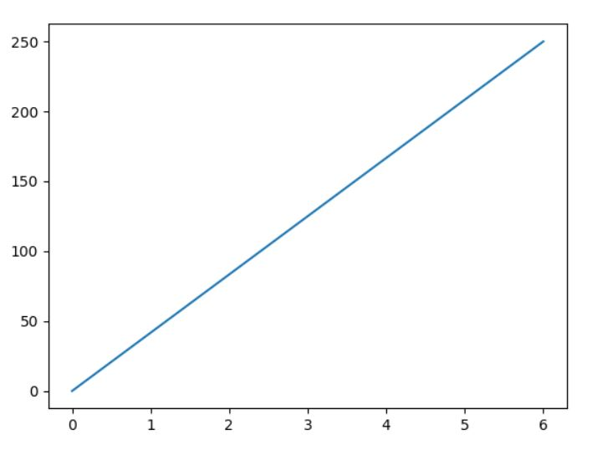
Matplotlib pyplot
The plot () function is used to draw points (markers) in a diagram. By default , the plot() function draws a line from point to point. The function takes parameters for specifying points in the diagram.
Parameter 1 is an array containing the points on the x_axis.
Parameter 2 is an array containing the points on the y_axis. we have to pass two arrays [0 , 6] and [0 , 250] to the plot function.
import matplotlib.pyplot as plt import numpy as np xpoints = np.array([0, 6]) ypoints = np.array([0, 250]) plt.plot(xpoints, ypoints) plt.show()

Slide 21
Matplotlib pyplot
Most of the Matplotlib utilities lies under the pyplot submodule, and are usually imported under the plt alias :
import matplotlib.pyplot as plt
Draw a line in a diagram from position (0,0) to position (6,250):
import matplotlib.pyplot as plt import numpy as np xpoints = np.array([0, 6]) ypoints = np.array([0, 250]) plt.plot(xpoints, ypoints) plt.show()

Slide 22
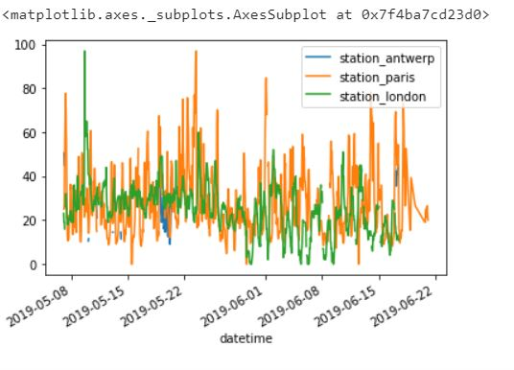
Index_col & parse_dates parameters
The usage of the index_col and parse_dates parameters of the read_csv function to define the first (0th) column as index of the resulting DataFrame and convert the dates in the column to Timestamp objects , respectively.
import pandas as pd
import matplotlib.pyplot as plt
df = pd.read_csv("air.csv" , index_col=0 , parse_dates = True)
df.plot()

Slide 23
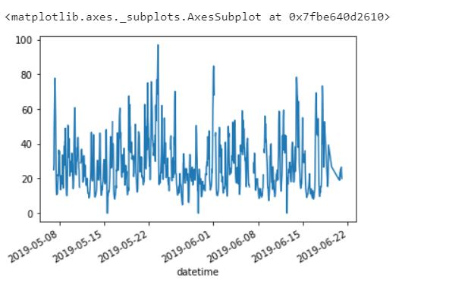
Plot the specific column
To plot a specific column , use the selection method of the subset data in combination with the plot() method. Hence , the plot() method works on both Series and DataFrame.
import pandas as pd
import matplotlib as plt
df = pd.read_csv("air.csv" , index_col = 0 , parse_dates = True)
df["station_paris"].plot()

Slide 24
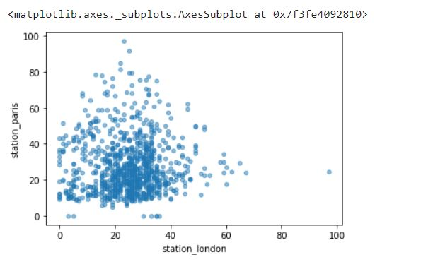
Comparison xlabel & ylable
We can visually compare measured values in two columns with each other. when you create a plot of a graph, by default, matplotlib will have the default transparency set (a transparency of 1). If you want to make the graph plot more transparent, then you can make alpha less than 1, such as 0.5 or 0.25 .
import pandas as pd
import matplotlib as plt
df = pd.read_csv("air.csv" , parse_dates = True)
df.plot.scatter(x = "station_london" , y = "station_paris" , alpha = 0.5)

Slide 25

Create new columns derived from existing columns
To create a new column , use the [] brackets with the new column name at the left side of the assignment.
in this example : we want to express the N$O_{2}$ concentration of the station in London in mg/$m^{3}(assume tempreture of 25 degrees Celsius and pressure of 1013hPa, the conversion factor is 1,882)$
import pandas as pd air_quality = pd.read_csv("air.csv" , index_col=0 , parse_dates=True) air_quality["london_mg_per_cubic"] = air_quality["station_london"] * 1.882 print(air_quality.head())

Slide 26
Rename column
The rename() function can be used for both row labels and column labels. Provide a dictionary with the keys the current names and the values the new names to update the corresponding names.
import pandas as pd
air_quality = pd.read_csv("air.csv" , index_col=0 , parse_dates=True)
air_quality_rename = air_quality.rename(
columns = {"station_antwerp":"station-A",
"station_london" :"station-L",
"station_paris" : "station-P"
})
print(air_quality_rename.head())

Slide 27
Aggregating statistics
Different statistics are available and can be applied to columns with numerical data. Operations in general exclude missing data and operate across rows by default.
The statistic applied to multiple columns of a DataFrame (the selection of two columns return a DtaFrame) is calculated for each numeric column.
Instead of the predefined statistics, specific combination of aggregating statistics for given columns can be defined using the DataFrame.agg() method
import pandas as pd olympia = pd.read_csv("olympia.csv") olympia_age_mean = olympia.agg({"Age":["min" , "max" , "median"]}) print(olympia_age_mean)
import pandas as pd
df = pd.read_csv("olympia.csv")
print(df["Age"].median())
Print(df[“Age”].describe()

Slide 28
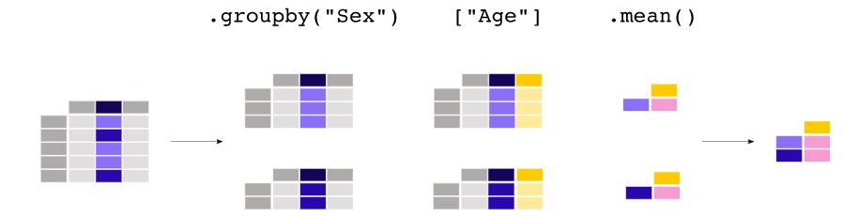
Aggregating statistics grouped by category
Any groupby() operation involves splitting operation on the original object. We split data into sets and we apply some functionality on each subset . In the apply functionality , we can perform Aggregating operation.
In this example our interest is the average age for every gender a subselection on these two columns made first , next the groupby() method is applied on the sex column to make a group per category!
import pandas as pd
df = pd.read_csv("olympia.csv")
df[["Sex" , "Age"]].groupby("Sex").mean()

Slide 29
Showing Basics Statistics
Now that you’ve seen what data types are in your dataset, it’s time to get an overview of the values each column contains. You can do this with .describe()
df.describe()
. describe() only analyzes numeric columns by default, but you can provide other data types if you use the include parameter:
import numpy as np
df.describe(include=np.object)
describe() won’t try to calculate a mean or a standard deviation for the object columns, since they mostly include text strings. However, it will still display some descriptive statistics

Slide 30
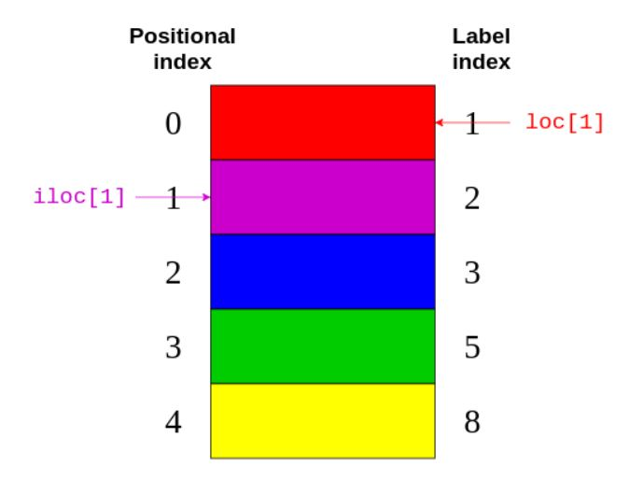
Using .loc and .iloc
Similar to series, a Data Frame also provides .loc and .iloc data access methods. Remember .loc uses the label and .iloc the positional index:
df.loc[1]
df.iloc[0]

